Slide 1
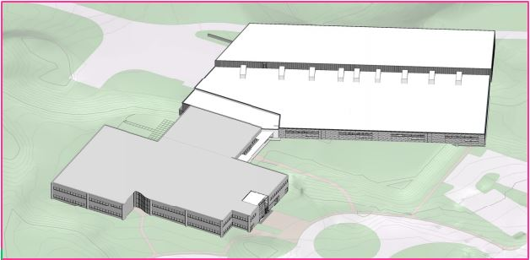
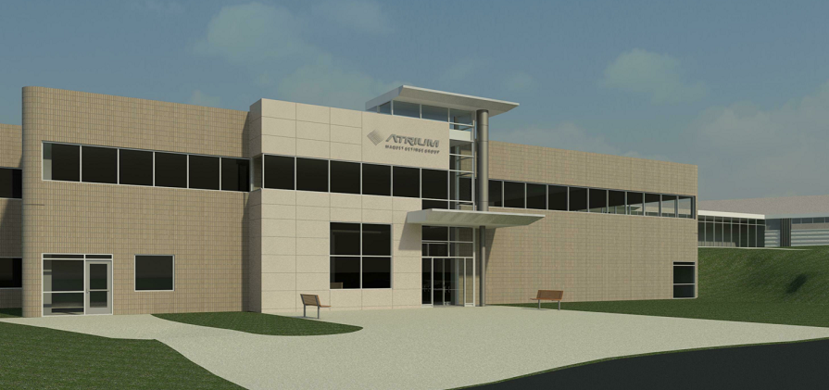
Atrium Medical Corporation
[Headquarters Facility]
Pennsylvania State University
Architectural Engineering
Senior Thesis Final Presentation
Atrium Medical Corporation
Headquarters Facility
Table of Contents
Project Information
Depth Analysis 1
Depth Analysis 2
Depth Analysis 3
Conclusion & Recommendations
Acknowledgements
Title Page
Ref: Atrium Medical Project Documents
Ref: Atrium Medical Project Documents
40 Continental Boulevard
Merrimack NH, 03054
Jeffrey Martin
Advisor: Dr. Leicht
April 16th, 2014

Slide 2
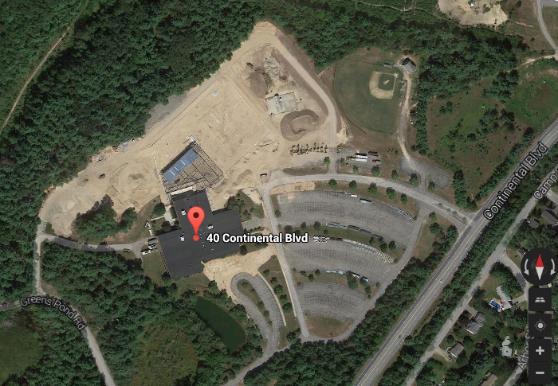
Atrium Medical Corporation
[Headquarters Facility]
Project Information:
Existing Conditions
Proposed 101,200 SF New Addition (Footprint)
Location: 40 Continental Boulevard, Merrimack, NH 03054
Site Size: 2,367,100 SF
Existing Structure: 2 Story building
114,000 SF
Previous Owner: Fidelity Investments
New Owner: Atrium Medical Corporation/ Maquet Getinge Group
Project Scope: Existing Renovation
101,200 SF New Addition
Table of Contents
Title Page
Depth Analysis 1
Depth Analysis 2
Depth Analysis 3
Conclusion & Recommendations
Acknowledgements
Project Information
Existing Conditions
Owner Information
Building Information
Ref: www.google.com/maps
Existing 100,000SF Building to be Renovated

Slide 3
Atrium Medical Corporation
[Headquarters Facility]
Project Information:
Owner Information
Project Owner: Atrium Medical Corporation/ MAQUET/GETINGE Group
Previous Owner: Fidelity Investments
Reason for Purchase: Company Expansion
Bring all 450 + Employees Into One Facility.
Divisions of Work: Manufacturing, Storage, Business Offices, R&D, Engineering Shops
Table of Contents
Title Page
Depth Analysis 1
Depth Analysis 2
Depth Analysis 3
Conclusion & Recommendations
Acknowledgements
Project Information
Existing Conditions
Owner Information
Building Information
Ref: www.theiddoctor.info
Specializes in R&D and Manufacturing
Cardiology
Radiology
Chest Trauma
Thoracic Drainage
Business unit of MAQUET Cardiovascular (Structured Alliance)
Member of GETINGE Group of companies
Ref: www.classiccapital.net

Slide 4
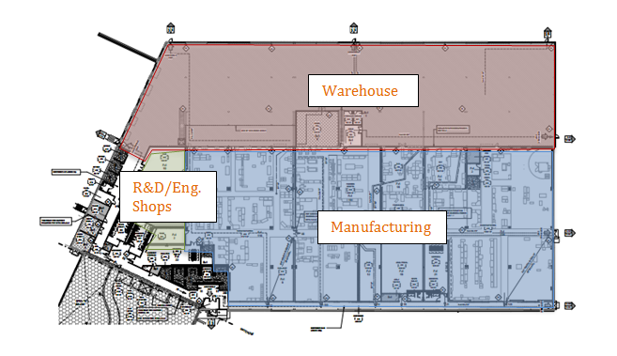
Atrium Medical Corporation
[Headquarters Facility]
Project Information:
Building Information
CM Firm: Hutter Construction
Architect: Lavallee Brensinger
Structural Engineer: Foley Buhl Roberts
Civil Engineer: Hayner Swanson Inc.
Mechanical Engineer: Johnson & Jordan Inc.
Electrical Engineer: Gate City Electric
Table of Contents
Title Page
Depth Analysis 1
Depth Analysis 2
Depth Analysis 3
Conclusion & Recommendations
Acknowledgements
Project Information
Existing Conditions
Owner Information
Building Information
Ref: Atrium Medical Project Documents
Project Location: 40 Continental Boulevard, Merrimack, NH 03054
Building Size: 101,200 SF
Zoning: I-3 Industrial
Description: Single Story Building
Interior Mezzanine
Ref: All Images found on www.google.com/images

Slide 5
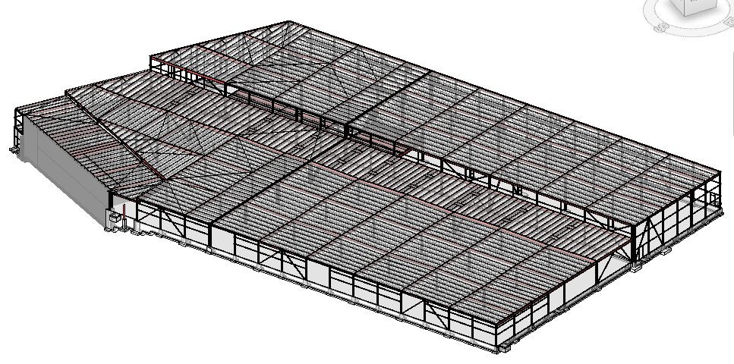
Atrium Medical Corporation
[Headquarters Facility]
Depth Analysis 1:
Problem Statement
Description of Structure:
Steel Structure: Atrium Medical Corporation
Table of Contents
Title Page
Project Information
Depth Analysis 2
Depth Analysis 3
Conclusion & Recommendations
Acknowledgements
Structure: Steel Superstructure
Beams: Wide Flange Steel Beams
Columns: Wide Flange Steel Columns
Roof Joists: K-Series Joists
Lateral Bracing: HSS Steel Sections
Foundations: Concrete spread & strip footings and piers
Depth Analysis 1
Problem Statement
Proposed Solution
Structural Breadth
Total Design Summary
Analysis Results
Problem: Owner not utilizing the opportunity to develop a more efficient structure, in regards to either cost or scheduling.
Ref: Atrium Medical Revit Structural Model

Slide 6
Atrium Medical Corporation
[Headquarters Facility]
Depth Analysis 1:
Proposed Solution
Sequence of Events:
Advantages of Precast Structures:
Table of Contents
Title Page
Project Information
Depth Analysis 2
Depth Analysis 3
Conclusion & Recommendations
Acknowledgements
Develop System Design (Precast Concrete)
Decrease in Project Schedule
Saves Space on-site
Saves Money (labor)
Structural Breadth
Depth Analysis 1
Problem Statement
Proposed Solution
Structural Breadth
Total Design Summary
Analysis Results
Select Precast Components
Develop Load Cases
Disadvantages of Precast Structures:
Size Precast Members
Availability
Timing
Small Margin of Error
High Material Cost
Depth Analysis
Perform Cost Analysis
Perform Install. Analysis
Results & System Comparison
Ref: All Images found on www.google.com/images

Slide 7
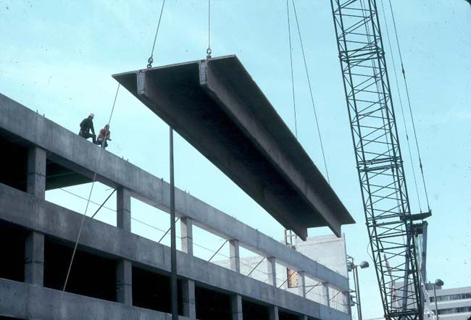
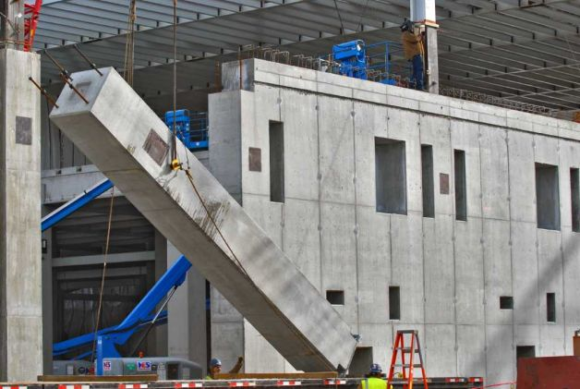
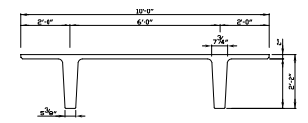
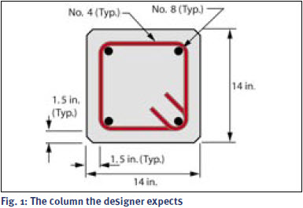
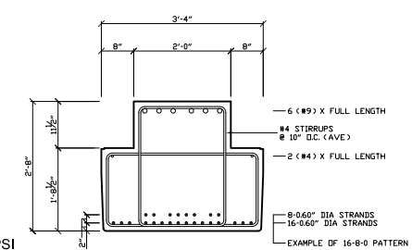
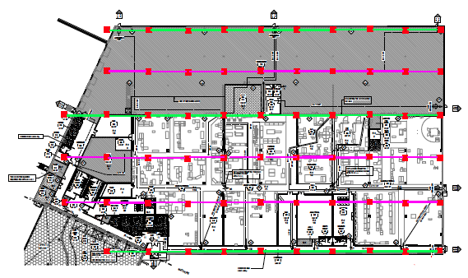
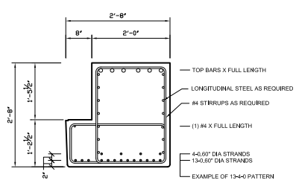
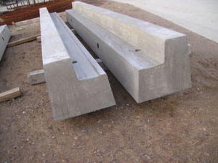
Depth Analysis 1:
Structural Breadth:
Developing a Design
Atrium Medical Corporation
[Headquarters Facility]
Double Tee Beam
Square Concrete Columns
Table of Contents
Title Page
Project Information
Depth Analysis 2
Depth Analysis 3
Conclusion & Recommendations
Acknowledgements
Ref: www.nitterhouse.com/technical-info
Ref: www.concretetech.com
Ref: www.condor-rebar.com
Inverted Tee Beam
Proposed System Layout
Depth Analysis 1
Problem Statement
Proposed Solution
Structural Breadth
Developing a Design
Determining Loads
Sizing Members
Total Design Summary
Analysis Results
Ref: www.timesunion.com
Column Line 6
Column Line 5
Ref: www.nitterhouse.com/technical-info
Ref: www.dynaspan.com
Column Line 4
Ledger Beam
Column Line 3
Column Line 2
Column Line 1
Ref: www.nitterhouse.com/technical-info
Ref: www.cpm-group.com
Ref: Atrium Medical Project Documents

Slide 8
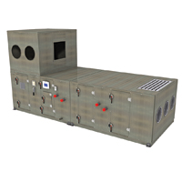
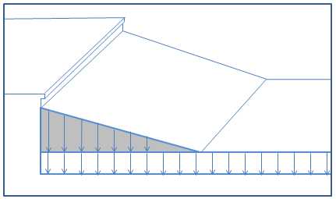
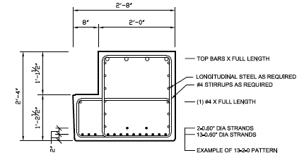
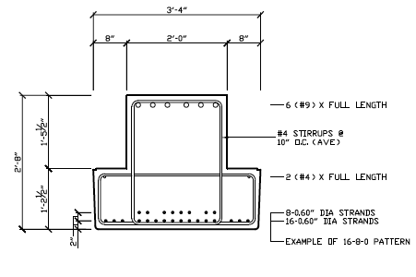
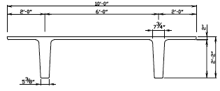
Depth Analysis 1:
Structural Breadth:
Determining Loads
Atrium Medical Corporation
[Headquarters Facility]
Mechanical Loads
Table of Contents
Title Page
Project Information
Depth Analysis 2
Depth Analysis 3
Conclusion & Recommendations
Acknowledgements
Snow Loads
Snow Drift Loads
Mechanical Loads
Superimposed Loads
Member Self Weights
Loads due to (8) AHU’s and (4) RTU’s
Act as point load(s) throughout roof
Maximum AHU load = 9000 lbs.
Snow Loads:
Snow Drift Loads:
Depth Analysis 1
Problem Statement
Proposed Solution
Structural Breadth
Developing a Design
Determining Loads
Sizing Members
Total Design Summary
Analysis Results
Ref: www.trane.com
Member Self Weights & Superimposed Loads
Loads from:
Double Tees
Ledger & Inverted Tee Beams
Superimposed Dead = 15 PSF
Ref: Atrium Medical Project Documents
Snow loads from structural drawings
Flat Roof Snow Load = 42 PSF
Two main roof levels
Lower Roof Height = 17’ 0”
Higher Roof Height = 27’ 8”
Max Surcharge = 92.31 PSF
Surcharge Length = 16.94
Ref: www.nitterhouse.com/technical-info

Slide 9
Depth Analysis 1:
Structural Breadth:
Sizing Members
Atrium Medical Corporation
[Headquarters Facility]
Double Tee Beam
9 kips
Beam Designs
Concrete Column Loads
Table of Contents
Title Page
Project Information
Depth Analysis 2
Depth Analysis 3
Conclusion & Recommendations
Acknowledgements
0.57 k/ft.
26”x10’ D.T (No Topping), 26-6.6P
Column Line # | Total Axial Loads
Column Line 1 | 178.4 kips
Column Line 2 | 409.6 kips
Column Line 3 | 426.8 kips
Column Line 4 | 463.1 kips
Column Line 5 | 409.6 kips
Column Line 6 | 178.4 kips
0.923k/ft.
Inverted Tee Beam
Depth Analysis 1
Problem Statement
Proposed Solution
Structural Breadth
Developing a Design
Determining Loads
Sizing Members
Total Design Summary
Analysis Results
Inverted Tee Beam 40IT36-A
6.083 k/ft.
Interior Ledger Beam
Concrete Column Designs
32LB28 (SP 13-6-0)
(TB 6 - #9)
Designs Selected For Columns by Column Line
Column Line 1 | 10" x 10" w/ 4 - #5 bars at 17 ft height
Column Line 2 | 10" x 10" w/ 4 - #10 bars at 17 ft height
Column Line 3 | 10" x 10" w/ 4 - #11 bars at 17 ft height
Column Line 4 | 12" x 12" w/ 4 - #8 bars at 27.5 ft height
Column Line 5 | 10" x 10" w/ 4 - #10 bars at 27.5 ft height
Column Line 6 | 10" x 10" w/ 4 - #5 bars at 27.5 ft height
4.289 k/ft.
Exterior Ledger Beam
18LB32 (SP 6-4-0) (TB 4 - #9)
2.875k/ft.

Slide 10
Depth Analysis 1:
Total Design Summary:
Cost Summary
Atrium Medical Corporation
[Headquarters Facility]
Total Precast Cost Summary:
Additional Footing Cost:
Table of Contents
Title Page
Project Information
Depth Analysis 2
Depth Analysis 3
Conclusion & Recommendations
Acknowledgements
Type | Quantity | Length | Unit | Mat'l Cost/Unit | Total Mat'l Cost | Labor/Equip. Cost/Unit | Total Labor/Equip. Cost
Double Tee Beam | 188 | 50 | LF | $18.00 | $169,200.00 | $700.00 | $131,600.00
Inverted Tee Beam | 29 | 40 | LF | $275.00 | $319,000.00 | $700.00 | $20,300.00
Interior Ledger Beam | 10 | 40 | LF | $275.00 | $110,000.00 | $700.00 | $7,000.00
Exterior Ledger Beam | 28 | 40 | LF | $275.00 | $308,000.00 | $700.00 | $19,600.00
Column Line 1 | 10 | 17 | LF | $275.00 | $46,750.00 | $700.00 | $7,000.00
Column Line 2 | 11 | 17 | LF | $275.00 | $51,425.00 | $700.00 | $7,700.00
Column Line 3 | 11 | 17 | LF | $275.00 | $51,425.00 | $700.00 | $7,700.00
Column Line 4 | 11 | 27.5 | LF | $275.00 | $83,187.00 | $700.00 | $7,700.00
Column Line 5 | 10 | 27.5 | LF | $275.00 | $75,625.00 | $700.00 | $7,000.00
Column Line 6 | 10 | 27.5 | LF | $275.00 | $75,625.00 | $700.00 | $7,000.00
 |  |  |  | Total | $1,290,237.00 | Total | $222,600.00
 |  |  |  | Total Initial System Cost |  |  | $1,512,837.00
Footing Type | Original Cost | Cost Increase (35%)
Spread Footings | $69,225.81 | $24,229.03
Strip Footings | $25,675.92 | $8,986.57
Additional Concrete Cost |  | $33,216.00
Depth Analysis 1
Problem Statement
Proposed Solution
Structural Breadth
Total Design Summary
Cost Summary
Installation Summary
Analysis Results
Initial System Cost: $1,512,837.00
+
Additional Footing Cost: $33,216.00
=
Total System Cost: $1,546,053.00

Slide 11
Depth Analysis 1:
Total Design Summary:
Installation Summary
Atrium Medical Corporation
[Headquarters Facility]
Total Precast Installation Summary:
Table of Contents
Title Page
Project Information
Depth Analysis 2
Depth Analysis 3
Conclusion & Recommendations
Acknowledgements
Type | Quantity
Double Tee Beam | 188
Inverted Tee Beam | 29
Interior Ledger Beam | 10
Exterior Ledger Beam | 28
Column Line 1 | 10
Column Line 2 | 11
Column Line 3 | 11
Column Line 4 | 11
Column Line 5 | 10
Column Line 6 | 10
Total Members | 318
# Picks per day | ~ 6 to 8
Days for completion | 40 to 53 Days
Depth Analysis 1
Problem Statement
Proposed Solution
Structural Breadth
Total Design Summary
Cost Summary
Installation Summary
Analysis Results
Ref: www.timesunion.com
Ref: www.dynaspan.com
Ref: www.concretetech.com
Total System Installation Time: 40 to 53 days

Slide 12
Atrium Medical Corporation
[Headquarters Facility]
Depth Analysis 1:
Analysis Results
Overall Systems Comparison and Analysis Results:
Adjusted Costs and Installation Times:
Table of Contents
Title Page
Project Information
Depth Analysis 2
Depth Analysis 3
Conclusion & Recommendations
Acknowledgements
 | Total Cost | Installation Time (days)
Precast Structural System (Proposed System) | $1,546,053.00 | 53 to 40
Steel Structural System (Original System) | $1,273,160.00 | 45
Difference | (+) $272,893.00 | (+) 8 to (-) 5
Costs
100 Ton Crane Rental Cost | $18,000.00
Add'l Cost of Precast System | $272,893.00
Total System Cost | $290,893.00
Installation Times
Total Steel Member Qty. | 318
# Picks per day (one crane) | ~6 to 8
# Picks per day (two cranes) | ~12 to 16
Total System Installation Time (days) | 20 to 26.5
Depth Analysis 1
Problem Statement
Proposed Solution
Structural Breadth
Total Design Summary
Analysis Results
Issues:
Cost is too high
Schedule decrease not significant
Solution:
Add another crane on-site
Revised Precast System Cost: $1,564,053
Revised Precast System Installation Time: 20 to 26.5 days

Slide 13
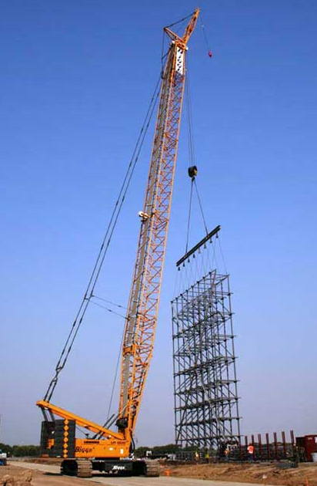
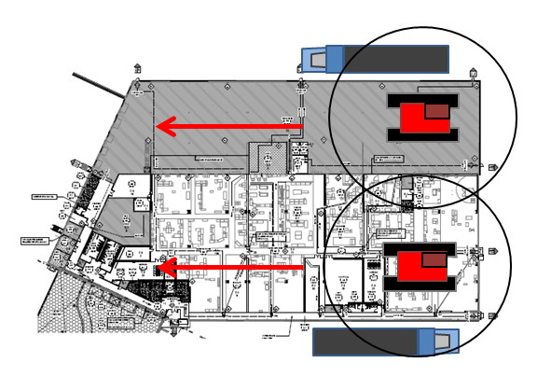
Atrium Medical Corporation
[Headquarters Facility]
Depth Analysis 1:
Analysis Results
Project will utilize (2) 100 Ton Crawler Cranes
Cranes will move within building footprint
(1) crane in Manufacturing area
(1) crane in Warehouse Area
Movement of work flow from East to West
Gives Total Installation time = 20 to 26.5 days
Table of Contents
Title Page
Project Information
Depth Analysis 2
Depth Analysis 3
Conclusion & Recommendations
Acknowledgements
Bed Trucks with Precast Members Move Along Building Perimeter for Ease of Access.
Truck
Warehouse
Crane 1
Depth Analysis 1
Problem Statement
Proposed Solution
Structural Breadth
Total Design Summary
Analysis Results
Crane 2
Manufacturing
Ref: www.bigge.com
Truck
Ref: Atrium Medical Project Documents

Slide 14
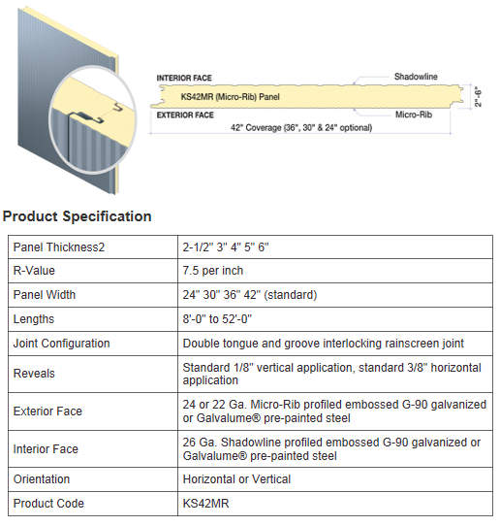
Atrium Medical Corporation
[Headquarters Facility]
Depth Analysis 2:
Problem Statement
Description of Envelope:
Table of Contents
Title Page
Project Information
Depth Analysis 1
Depth Analysis 3
Conclusion & Recommendations
Acknowledgements
Design Kingspan Micro-Rib Insulated Metal Panels
Location: Exterior Warehouse Area
Area (SF)
Southern Face: 3,106 SF
Eastern Face: 2,788 SF
Northern Face: 10,401 SF
Western Face: 4,016 SF
Depth Analysis 2
Problem Statement
Proposed Solution
Mechanical Breadth
Total Design Summary
Analysis Results
Problem: Owner not utilizing the opportunity to create a more efficient building envelope surrounding the warehouse area.
Ref: www.kingspanpanels.us

Slide 15
Atrium Medical Corporation
[Headquarters Facility]
Depth Analysis 2:
Proposed Solution
Sequence of Events:
Advantages of Precast Insulated Panels:
Table of Contents
Title Page
Project Information
Depth Analysis 1
Depth Analysis 3
Conclusion & Recommendations
Acknowledgements
Develop System Design (Precast Insulated Panels)
Decrease Time in Project Schedule
Versatility
Energy & Thermal Efficiency
Fire Resistance
Mech. Breadth
Description of Systems
Depth Analysis 2
Problem Statement
Proposed Solution
Mechanical Breadth
Total Design Summary
Analysis Results
Thermal Analysis of Systems
Disadvantages of Precast Insulated Panels:
Compare Thermal Efficiency‘s
High Materials Cost
Timing
Depth Analysis
Perform Cost Analysis
Perform Install. Analysis
Results & System Comparison

Slide 16
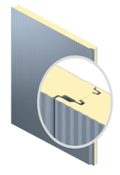
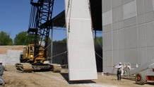
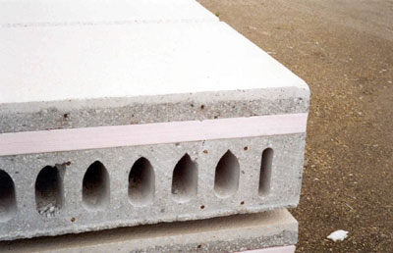
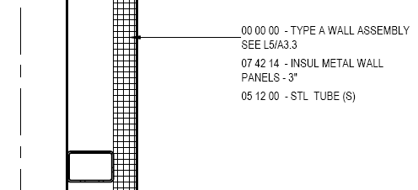
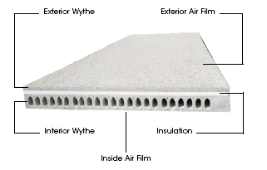
Depth Analysis 2:
Mechanical Breadth:
Description of Systems
Atrium Medical Corporation
[Headquarters Facility]
Original System:
Insulated Metal Panels
Proposed System:
Precast Insulated Panels
Table of Contents
Title Page
Project Information
Depth Analysis 1
Depth Analysis 3
Conclusion & Recommendations
Acknowledgements
Depth Analysis 2
Problem Statement
Proposed Solution
Mechanical Breadth
Description of Systems
Thermal Analysis & Results
Total Design Summary
Analysis Results
Ref: www.spancrete.com
Ref: Atrium Medical Project Documents
Ref: www.spancrete.com
Ref: www.spancrete.com
Ref: www.kingspanpanels.us

Slide 17
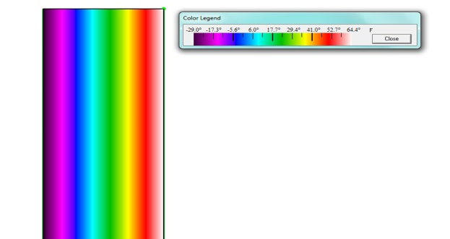
Depth Analysis 2:
Mechanical Breadth:
Thermal Analysis & Results
Atrium Medical Corporation
[Headquarters Facility]
Insulated Metal Panels: Summer Conditions
Insulated Metal Panels: Winter Conditions
Table of Contents
Title Page
Project Information
Depth Analysis 1
Depth Analysis 3
Conclusion & Recommendations
Acknowledgements
Depth Analysis 2
Problem Statement
Proposed Solution
Mechanical Breadth
Description of Systems
Thermal Analysis & Results
Total Design Summary
Analysis Results

Slide 18
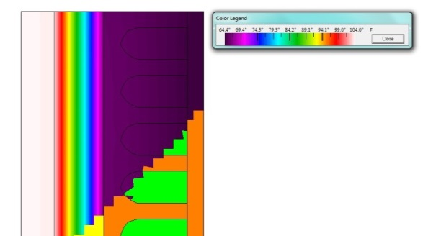
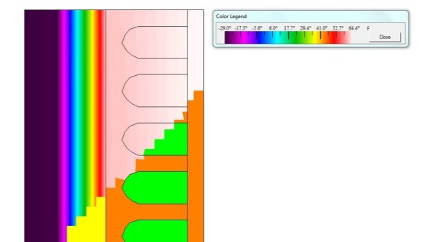
Depth Analysis 2:
Mechanical Breadth:
Thermal Analysis & Results
Atrium Medical Corporation
[Headquarters Facility]
Precast Insulated Panels: Summer Conditions
Precast Insulated Panels: Winter Conditions
Table of Contents
Title Page
Project Information
Depth Analysis 1
Depth Analysis 3
Conclusion & Recommendations
Acknowledgements
Depth Analysis 2
Problem Statement
Proposed Solution
Mechanical Breadth
Description of Systems
Thermal Analysis & Results
Total Design Summary
Analysis Results

Slide 19
Depth Analysis 2:
Total Design Summary:
Cost Summary
Atrium Medical Corporation
[Headquarters Facility]
Precast Insulated Panel Cost:
Table of Contents
Title Page
Project Information
Depth Analysis 1
Depth Analysis 3
Conclusion & Recommendations
Acknowledgements
Location |  | Area (ft²) | Unit | Material $/Unit | Material $
Southern Face |  | 3106 | SF | 18 | $ 55,908.00
Eastern Face |  | 2788 | SF | 18 | $ 50,184.00
Northern Face |  | 10401 | SF | 18 | $ 187,218.00
Western Face |  | 4016 | SF | 18 | $ 72,288.00
 |  |  |  |  | $ 365,598.00
Location |  | Quantity | Unit | Labor/Equip $/Unit | Labor/Equip $
Southern Face |  | 14 | Ea. | 700 | $ 9,800.00
Eastern Face |  | 13 | Ea. | 700 | $ 9,100.00
Northern Face |  | 47 | Ea. | 700 | $ 32,900.00
Western Face |  | 18 | Ea. | 700 | $ 12,600.00
 |  |  |  |  | $ 64,400.00
 |  |  |  | Total Cost | $ 429,998.00
Additional Footing Cost:
Footing Type | Original Cost | Cost Increase (35%)
Spread Footings | $40,631.00 | $14,221.00
Additional Concrete Cost |  | $14,221.00
Depth Analysis 2
Problem Statement
Proposed Solution
Mechanical Breadth
Total Design Summary
Cost Summary
Installation Summary
Analysis Results
Initial System Cost: $429,998.00
+
Additional Footing Cost: $14,221.00
=
Total System Cost: $444,219.00

Slide 20
Depth Analysis 2:
Total Design Summary:
Installation Summary
Atrium Medical Corporation
[Headquarters Facility]
Precast Insulated Panel Install Time:
Table of Contents
Title Page
Project Information
Depth Analysis 1
Depth Analysis 3
Conclusion & Recommendations
Acknowledgements
Location |  | Area (ft²) |  | Member Area (ft2) | Quantity (Area/Member Area)
Southern Face |  | 3106 |  | 221.36 | 14
Eastern Face |  | 2788 |  | 221.36 | 13
Northern Face |  | 10401 |  | 221.36 | 47
Western Face |  | 4016 |  | 221.36 | 18
 | Total Quantity |  |  |  | 92
 | # Picks per Day |  |  |  | ~6 to 8
 | Total Installation Time |  |  |  | 12 to 15
Depth Analysis 2
Problem Statement
Proposed Solution
Mechanical Breadth
Total Design Summary
Cost Summary
Installation Summary
Analysis Results
Ref: www.spancrete.com
Ref: www.spancrete.com
Total System Installation Time: 12 to 15 days

Slide 21
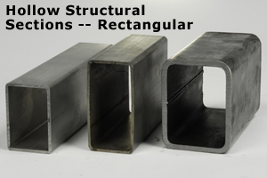
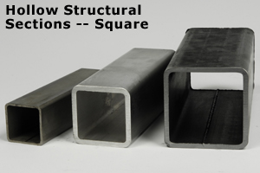
Atrium Medical Corporation
[Headquarters Facility]
Depth Analysis 2:
Analysis Results
Insulated Metal Panel Costs:
Table of Contents
Title Page
Project Information
Depth Analysis 1
Depth Analysis 3
Conclusion & Recommendations
Acknowledgements
Insulated Metal Panel System Cost
Subtotal |  | $354,400.00
HSS Framing Cost (+) |  | $46,355.00
Metal Panel Cost (-) |  | $31,007.00
Total System Cost |  | $369,748.00
Overall Systems Comparison and Analysis Results:
 |  | Total Cost | Installation Time (days)
Precast Insulated Panels |  | $444,219.00 | 12 to 15
Insulated Metal Panels |  | $369,748.00 | 50
Difference |  | (+) $74,471 | (-) 38 to (-) 35
Ref: www.bossteel.com
Depth Analysis 2
Problem Statement
Proposed Solution
Mechanical Breadth
Total Design Summary
Analysis Results
Ref: www.bossteel.com
Insulated Metal Panel Installation Time:
Total Wall Panel System Installation Time = |  |  |  | 67 Days
System Type |  | Area (ft^2) | % of Install. Time |  | Total Install. Time (days)
Metal Wall Panels |  | 7,112 | 26% |  | 17
Insulated Metal Panels |  | 20,311 | 74% |  | 50
Total = |  | 27,423 | 100% |  | 67

Slide 22
Atrium Medical Corporation
[Headquarters Facility]
Depth Analysis 3:
Problem Statement
Summary of Safety Plan:
Formal safety plan for field and office staff during construction
Superintendents have OSHA 30-Hour training
All other employees have OSHA 10-Hour training.
Weekly toolbox talks
Basic construction safety (i.e. PPE, Equip. Safety etc.)
Hutter Construction on Safety:
Table of Contents
Title Page
Project Information
Depth Analysis 1
Depth Analysis 2
Conclusion & Recommendations
Acknowledgements
“Training is an integral part of Hutter’s safety commitment. In addition to the traditional weekly toolbox talks, ongoing safety training is regularly provided by outside professionals. Among the topics continually addressed: competent persons, confined space, boom lifts, forklifts, snorkel lifts, CPR and first aid. All of our employees, including project managers have received the OSHA 10-Hour certified training and new employees receive the training within 30 days of hire. All of our superintendents have received OSHA 30-Hour training.”
Depth Analysis 3
Problem Statement
Proposed Solution
PtD Industry
System Selection
Typical Steel Connections
NISD Details
Analysis Results
Ref: www.hutterconstruction.com
Problem: Owner not utilizing the opportunity to plan and design for safety consideration prior to project’s construction.

Slide 23
Atrium Medical Corporation
[Headquarters Facility]
Depth Analysis 3:
Proposed Solution
Benefits of Implementing a Design Guide:
Table of Contents
Title Page
Project Information
Depth Analysis 1
Depth Analysis 2
Conclusion & Recommendations
Acknowledgements
Increase Safety Consideration
Increase in Quality Control
Reduce Delays
Increase in Productivity
Increase Collaboration between Designer & Constructors
Sequence of Events:
PtD Industry
System Selection Based on Risk
Depth Analysis 3
Problem Statement
Proposed Solution
PtD Industry
System Selection
Typical Steel Connections
NISD Details
Analysis Results
Typical Steel Connections
Barriers of Implementing a Design Guide:
NISD Details
Designer’s Liability
Additional Costs
Lack of Expertise
Analysis Results

Slide 24
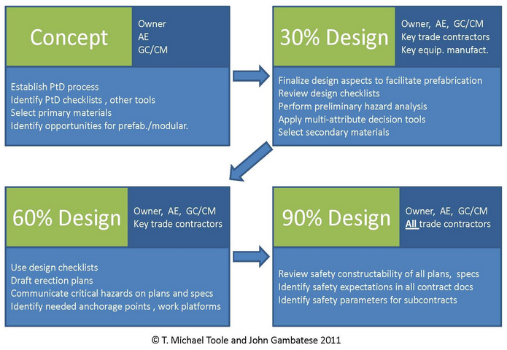
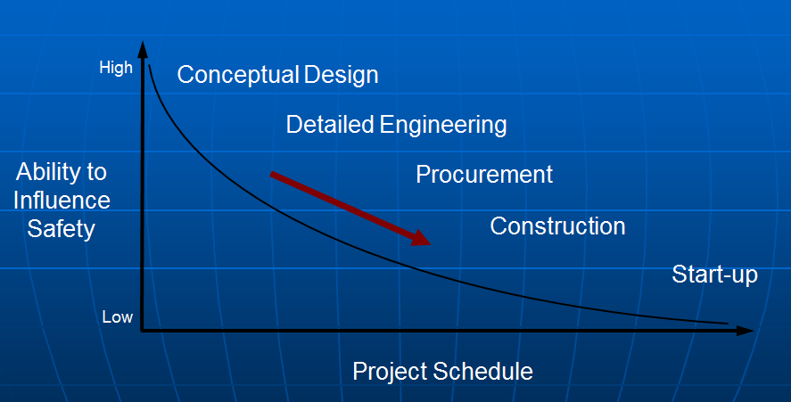
Atrium Medical Corporation
[Headquarters Facility]
Depth Analysis 3:
Prevention through Design Industry
Prevention through Design (PtD):
Prevention through Design Process:
Table of Contents
Title Page
Project Information
Depth Analysis 1
Depth Analysis 2
Conclusion & Recommendations
Acknowledgements
Industry developed to prevent hazards from occurring during construction
Began in late 90’s
Construction tasks & processes viewed during conceptual and design phase
Ensures safety of workers during construction
Depth Analysis 3
Problem Statement
Proposed Solution
PtD Industry
System Selection
Typical Steel Connections
NISD Details
Analysis Results
Ref: www.designforconstructionsafety.org
Ref: www.asse.org
As the timeline of the project schedule increase, the ability to influence safety on the project decreases.
Ref: www.lhsfna.org
Ref: www.elcosh.org
Ref: www.asse.org

Slide 25
Atrium Medical Corporation
[Headquarters Facility]
Depth Analysis 3:
System Selection
SliDeRulE Information:
SliDeRulE Results
Table of Contents
Title Page
Project Information
Depth Analysis 1
Depth Analysis 2
Conclusion & Recommendations
Acknowledgements
Safety in Design Risk Evaluator
Program designed to interpret the level of construction safety risk for a particular project.
This program is used primarily for:
Determining the level of safety risk for an entire building and each system within that building
Comparing designs based on risks
Learning about design features that could potentially increase or decrease risk
Creating building designs that minimize the risk of injury for construction workers
System Name | Safety Risk | Risk Percentage
Foundation |  | 4%
Structural Frame |  | 28%
Exterior Enclosure |  | 18%
Roof |  | 15%
Interiors |  | 5%
Plumbing |  | 1%
HVAC |  | 17%
Electrical |  | 13%
Depth Analysis 3
Problem Statement
Proposed Solution
PtD Industry
System Selection
Typical Steel Connections
NISD Details
Analysis Results
Ref: www.constructionsliderule.org

Slide 26
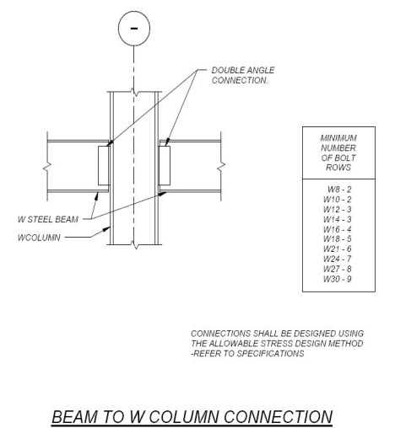
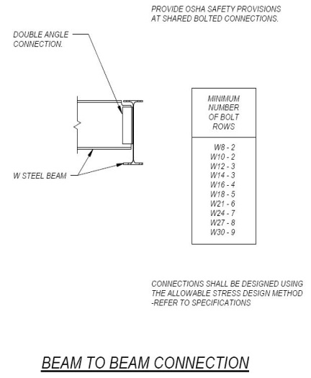
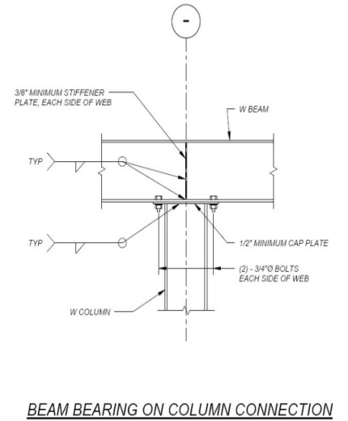
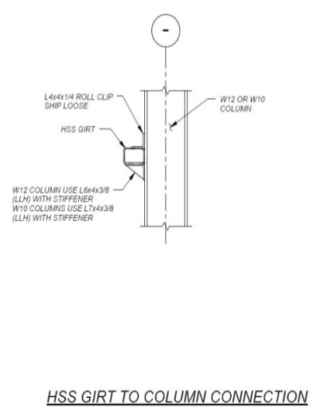
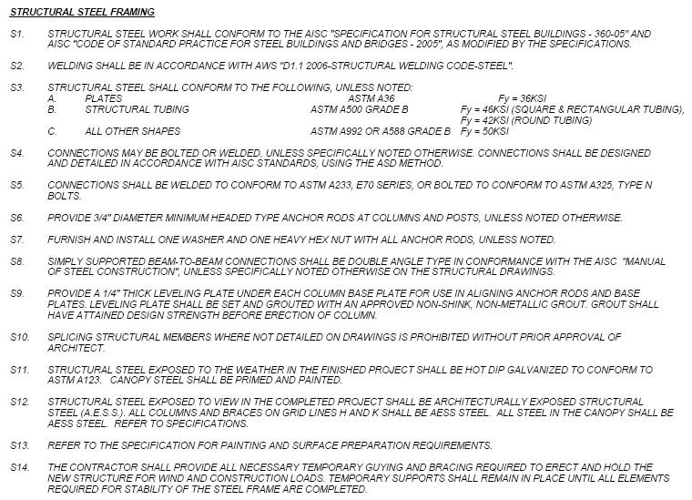
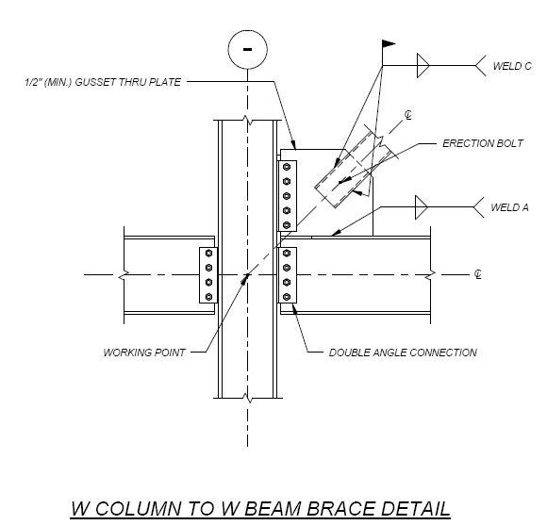
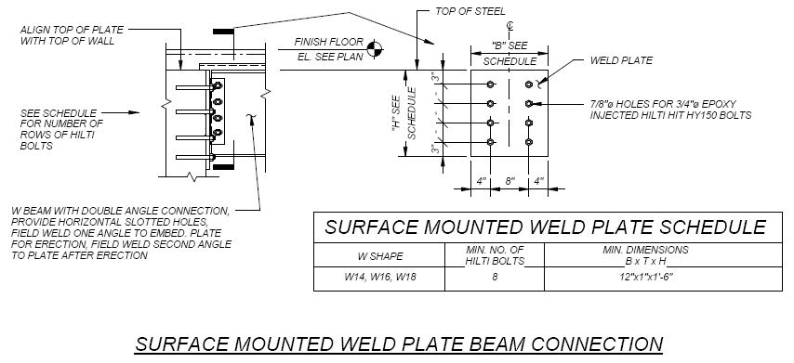
Atrium Medical Corporation
[Headquarters Facility]
Depth Analysis 3:
Typical Steel Connections
Table of Contents
Title Page
Project Information
Depth Analysis 1
Depth Analysis 2
Conclusion & Recommendations
Acknowledgements
Depth Analysis 3
Problem Statement
Proposed Solution
PtD Industry
System Selection
Typical Steel Connections
NISD Details
Analysis Results
Ref: All Snips from Atrium Medical Project Documents
Ref: Atrium Medical Project Documents

Slide 27
Atrium Medical Corporation
[Headquarters Facility]
Depth Analysis 3:
NISD Industry Standard Details
Table of Contents
Title Page
Project Information
Depth Analysis 1
Depth Analysis 2
Conclusion & Recommendations
Acknowledgements
Depth Analysis 3
Problem Statement
Proposed Solution
PtD Industry
System Selection
Typical Steel Connections
NISD Details
Analysis Results
Ref: www.NISD.org
Ref: www.NISD.org
Ref: www.NISD.org
Ref: www.NISD.org

Slide 28
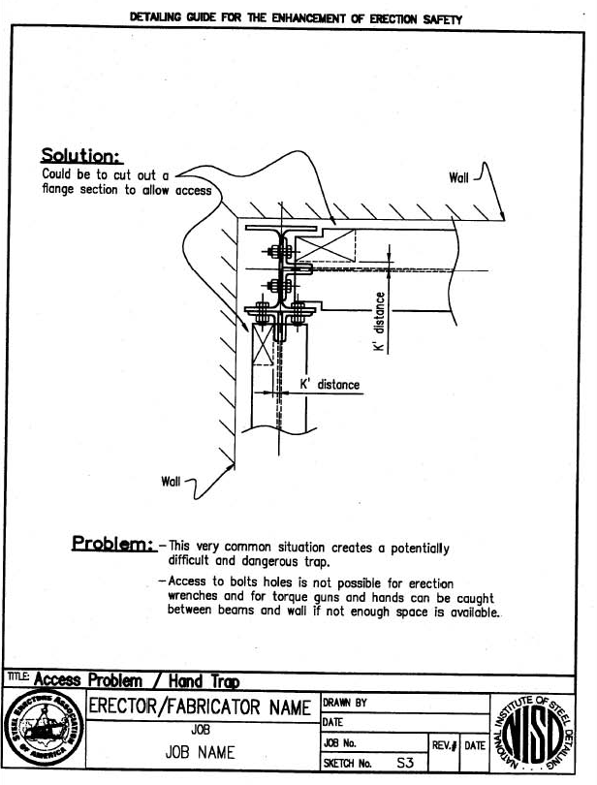
Atrium Medical Corporation
[Headquarters Facility]
Depth Analysis 3:
NISD Industry Standard Details
Table of Contents
Title Page
Project Information
Depth Analysis 1
Depth Analysis 2
Conclusion & Recommendations
Acknowledgements
Depth Analysis 3
Problem Statement
Proposed Solution
PtD Industry
System Selection
Typical Steel Connections
NISD Details
Analysis Results
Ref: www.NISD.org
Ref: www.NISD.org
Ref: www.NISD.org
Ref: www.NISD.org

Slide 29
Atrium Medical Corporation
[Headquarters Facility]
Depth Analysis 3:
Analysis Results
Overall Benefits of a Design Guide
Table of Contents
Title Page
Project Information
Depth Analysis 1
Depth Analysis 2
Conclusion & Recommendations
Acknowledgements
Developed to ensure safety of workers during construction
If properly implemented, problems can be foreseen and therefore prevented
Encourages collaboration between designer and constructor
Creates a better working relationship, less “lost in translation” incidents
Ensures quality control, as issues during design can be managed and adjusted if necessary
Depth Analysis 3
Problem Statement
Proposed Solution
PtD Industry
System Selection
Typical Steel Connections
NISD Details
Analysis Results
Ref: www.NISD.org

Slide 30
Atrium Medical Corporation
[Headquarters Facility]
Conclusions & Recommendations
Depth Analysis 1:
Depth Analysis 2:
Conclusion
Precast structural system imposed a $1,564,053.00 cost, with the use of (2) 100 ton crawler cranes and 20 to 26.5 days for installation
Cost is $290,893.00 greater than original steel structure
18.5 to 25 days less than structural steel installation
Recommendation
Install the precast concrete structure, to save time on the critical path of the project schedule
Conclusion
Precast insulated panels cost a total of $444,219.00, and require 12 to 15 days for installation. The panels also have a thermal efficiency (R-Value) of 23.78
Cost is $74,471.00 greater than original envelope system
Installation time is 35 to 38 days less than original envelope
R-Value of this system is 1.64 greater than original envelope
Recommendation
Install the precast insulated panels to save time during installation
Table of Contents
Title Page
Project Information
Depth Analysis 1
Depth Analysis 2
Depth Analysis 3
Acknowledgements
Conclusions & Recommendations
Depth Analysis 3:
Conclusion
Design guide focused on basic steel installation/connection issues, as well as specific details pertaining to connections typically found within Atrium Medical
Recommendation
Pay the additional upfront fee to hire design professionals and implement a design guide

Slide 31
Atrium Medical Corporation
[Headquarters Facility]
Acknowledgments
Academic Acknowledgements
Thank you:
Industry Acknowledgements
Thank you:
Table of Contents
Title Page
Project Information
Depth Analysis 1
Depth Analysis 2
Depth Analysis 3
Conclusion & Recommendations
Dr. Robert M Leicht
Dr. Ali M. Memari, P.E.
Moses D.F. Ling, P.E., RA
Special Thanks to:
Alyssa Stangl - fellow AE student/girlfriend
Garrett Schwier – fellow AE student/chair
All of my family and friends
David Lage
Les Somero
Bill Moyer
Daniel Zartman
Sean Landry
Acknowledgements

Slide 32
Atrium Medical Corporation
[Headquarters Facility]
Table of Contents
Title Page
Project Information
Depth Analysis 1
Depth Analysis 2
Depth Analysis 3
Conclusion & Recommendations
Acknowledgements
Questions?

